Slide 1
CASE STUDY IN RELATIONAL DATABASE DESIGN

Slide 2
TITLE: E-COMMERCE
STUDENTS NAME: UJJWAL SOHAL, SARTHAK GARG, SEHAJ SINGH, SHIVANKIT SINGH, SPARSH BANSAL, SUSHANT MISHRA.
GUIDE: Mrs. ADITI MOUDGIL

Slide 3
Contents:
Abstract .................................................................................................................................
Acknowledgments ..................................................................................................................................
Chapter 1:
Introduction
.................................................................................................................................
Chapter 2: Name of Case
Study............................................................................................... . ..................................
3.1 Case Study INFORMAL DESCRIPTION
3.2 Terminologies and Symbols of E-R diagram
3.3 case study LOGICAL MODEL (ER Diagram)
3.4 case study Physical schema
3.5 Case Study INTERACTIVE QUERIES
Chapter 3: Conclusion
Bibliography......................................................................................................

Slide 4
Abstract
The objective of this thesis is, E-commerce brings convenience for customers as they do not have to leave home and only need to browse websites online, especially for buying the products which are not sold in nearby shops. It could help customers buy a wider range of products and save customers' time. Consumers also gain power through online shopping. One case study “ECOMMERCE” is presented. Input for this case study is taken from its informal specification to a relational schema using entity-relationship modelling and its translation to relational model, to database schema, to implementation of the database, to interactive SQL querying of the installed database (SQL/ Oracle).

Slide 5
Functional Requirement:
Admin can view details of customers who have not purchased anything.
Admin can view the products purchased on a particular date.
A new user can register on the website.
Customers can filter the product based on the product details.
A customer can view the total price of the product present in the cart.
Admin can start a sale with a certain discount on every product.

Slide 6
Acknowledgments
I would like to express my gratitude to all of those who made it possible to complete this thesis, in particular to my supervisor Mrs. Aditi Moudgil, who believed in me and motivated me.

Slide 7
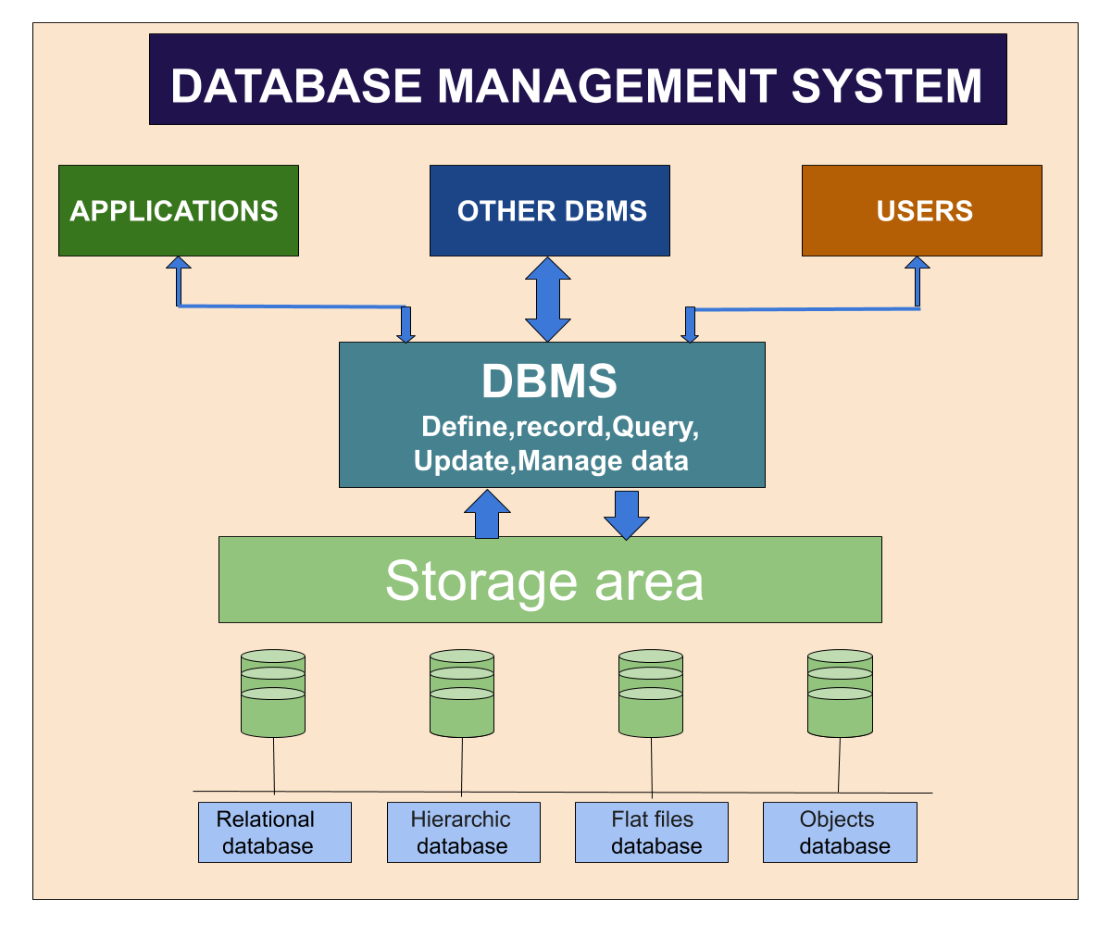
Chapter 1: Introduction
Database Management Systems:
A database management system (or DBMS) is essentially nothing more than a computerized data keeping system. Users of the system are given facilities to perform several kinds of operations on such a system for either manipulation of the data in the database or the management of the database structure itself.

Slide 8
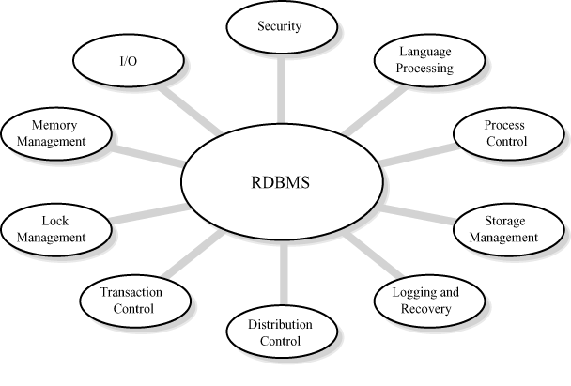
Relational Database Management System:
A relational database is a type of database that stores and provides access to data points that are related to one another. The columns of the table hold attributes of the data, and each record usually has a value for each attribute, making it easy to establish the relationships among data points.

Slide 9
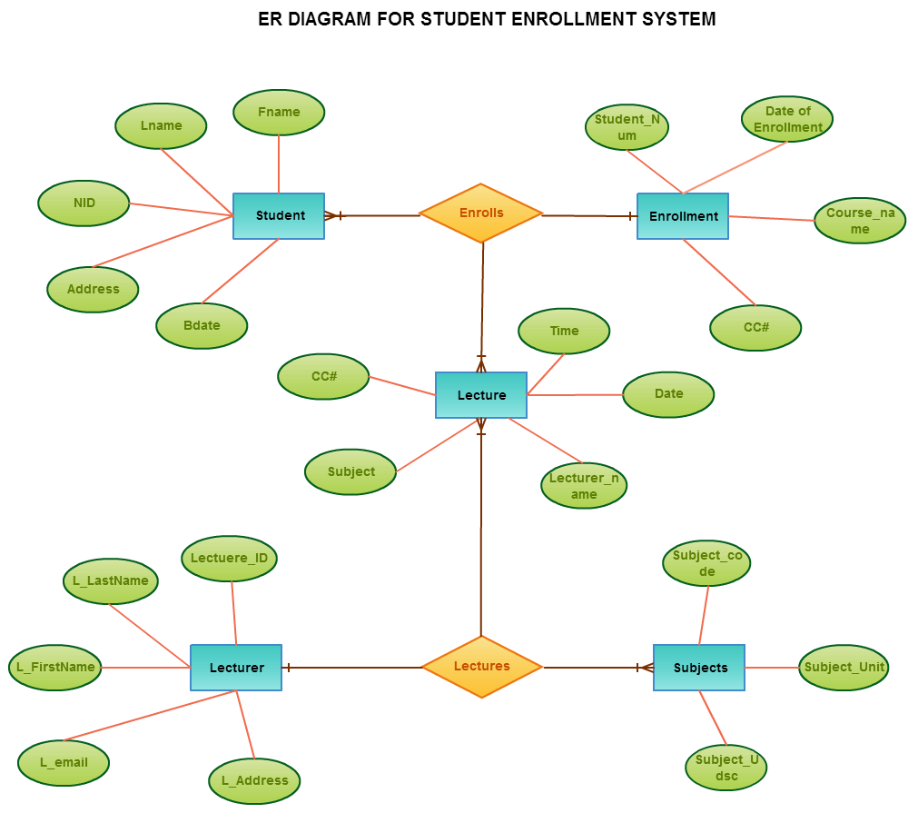
ER Diagram:
An Entity–relationship model (ER model) describes the structure of a database with the help of a diagram, which is known as Entity Relationship Diagram (ER Diagram). An ER model is a design or blueprint of a database that can later be implemented as a database. The main components of the E-R model are: entity set and relationship set.

Slide 10
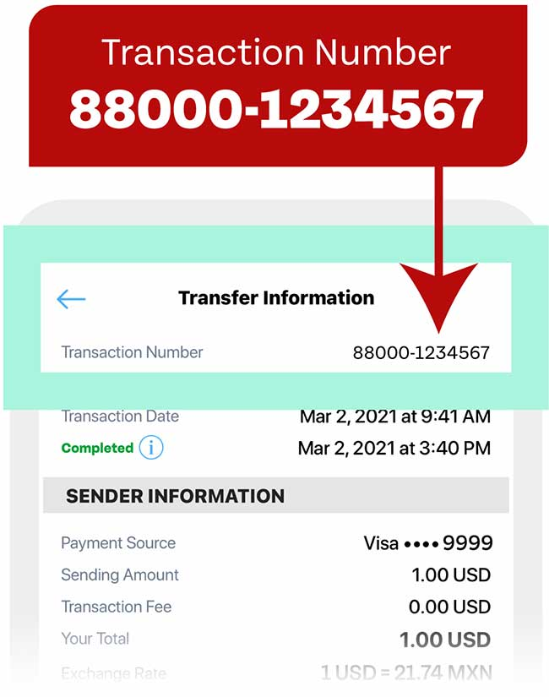
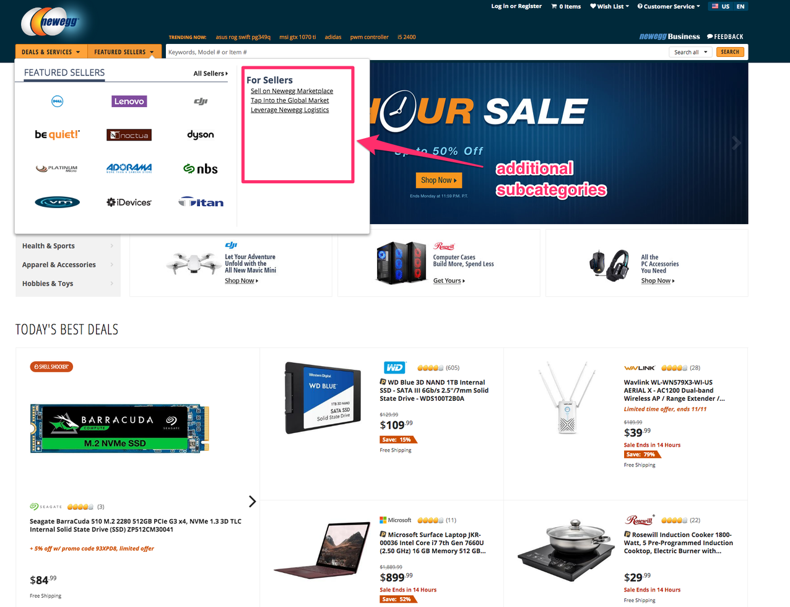
Objective of the case study:
Track Transactions. (Fig(a))
Organize Product.
Provide Structure to your stored data. (Fig(b))
Brief introduction of case study:
The main purpose to a database is to store information. Have a question about a customer order? Check the database. Want to know a product price? Check the database.
By using a database, a web application can ignore the actual data and focus more on the presentation and behaviour of that data. The end result is that the amount of code and logic in the web application is much smaller and easier to understand.
Figure (a)
Figure (b)

Slide 11
Chapter 2: Name of Case Study
3.1 Case study Informal Description:
The objective of this thesis is, E commerce brings convenience for customers as they do not have to leave home and only need to browse websites online, especially for buying the products which are not sold in nearby shops. It could help customers buy a wider range of products and save customers' time. Consumers also gain power through online shopping. One case study “ECOMMERCE” is presented. Input for this case study is taken from its informal specification to a relational schema using entity-relationship modelling and its translation to relational model, to database schema, to implementation of the database, to interactive SQL querying of the installed database (SQL/Oracle).

Slide 12
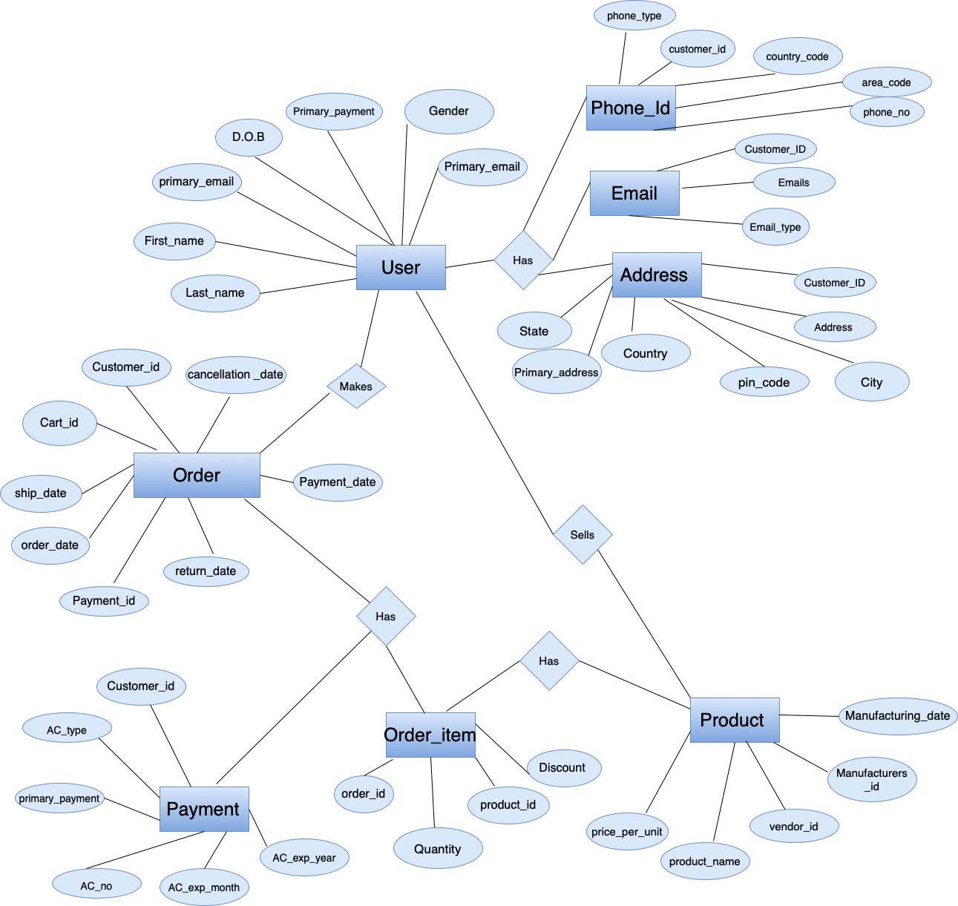
3.2 Case study Logical Model:

Slide 13
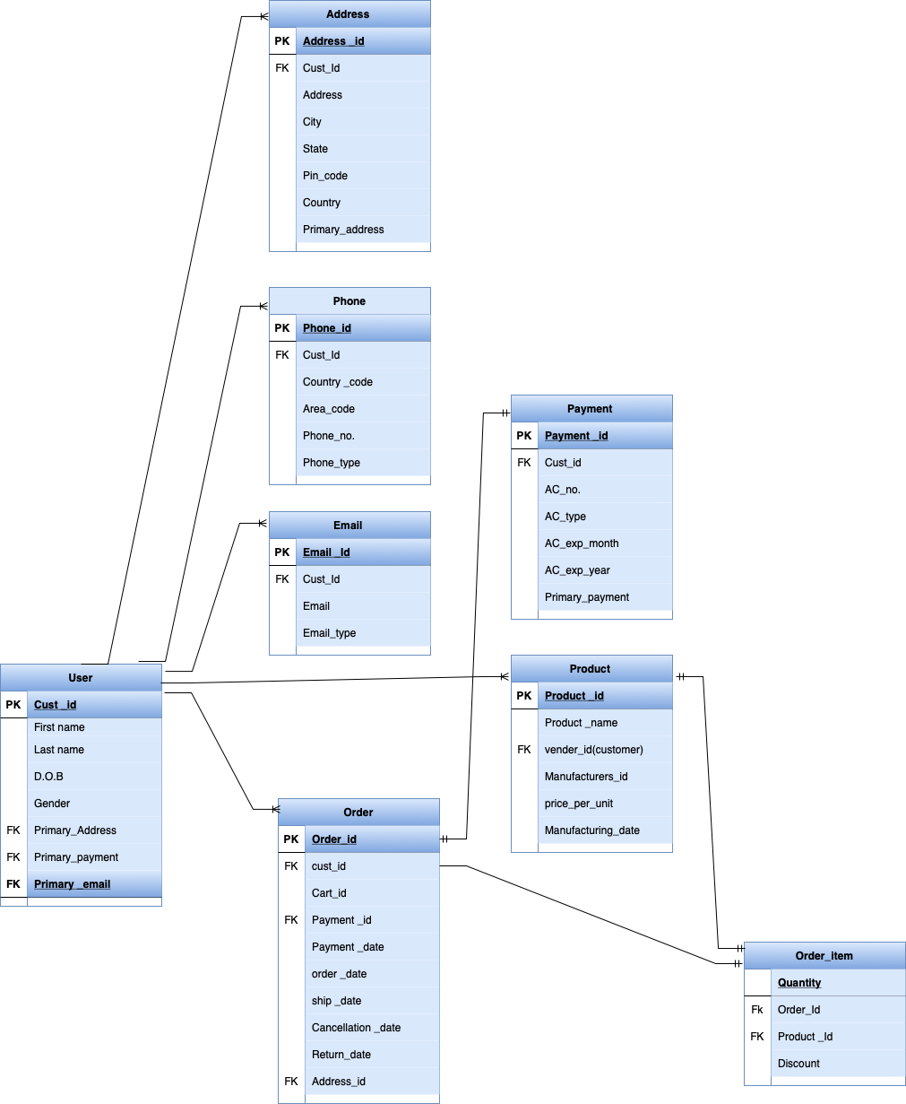

Slide 14
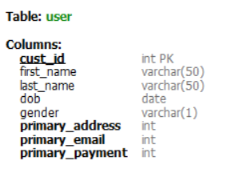
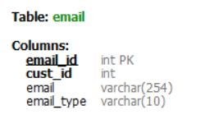
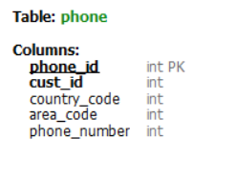
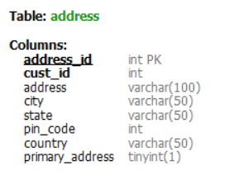
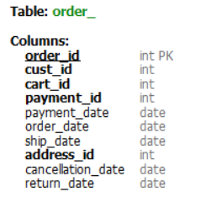
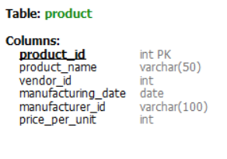
3.3 Case Study Physical Model:

